Slide 1

Mini Desktop Assistant
A Project Report By:
Priyanshu Khambalkar (206230307068)
Raj Lalwani (206230307161)
Jattin Rathod (206230307001)
Darpan Makwana (206230307009)

Slide 2
Project objective
1

Slide 3
1.1 Project Objective
The objective of an intelligent virtual assistant is to answer questions that users may have.
The main objective of this project is to perform tasks such as playing music and opening application, send/schedule emails and WhatsApp texts over voice command.
Response are formulated using text-to-speech featured.

Slide 4
Hardware & software requirement
2

Slide 5
Client side Requirement
2.1 Hardware Requirement
Pentium-pro processor or later.
RAM 512MB or more.
2.2 Software Requirement
Windows 7(32-bit) or above.
Chrome Driver •

Slide 6
Data diagram
3

Slide 7
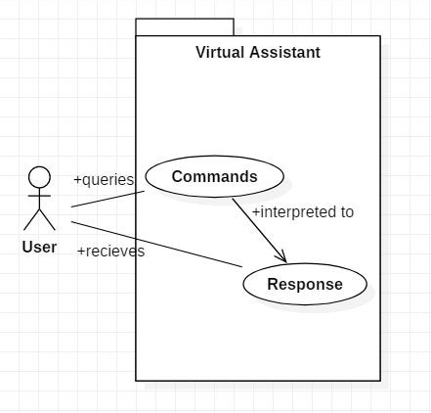
3.1 Use case Diagram

Slide 8
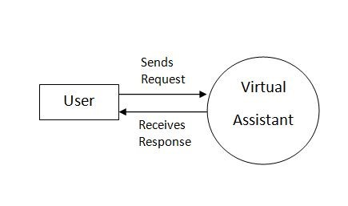
3.2 DFD Diagram
DFD Level 0 (Context Level Diagram)

Slide 9
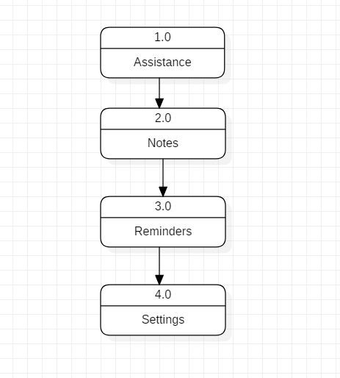
DFD Level 1

Slide 10
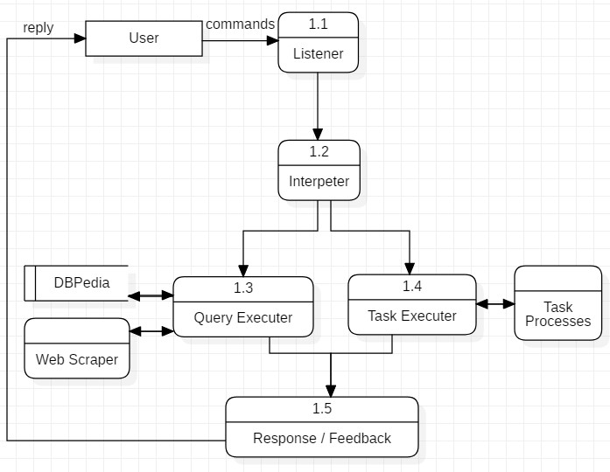
DFD Level 2

Slide 11
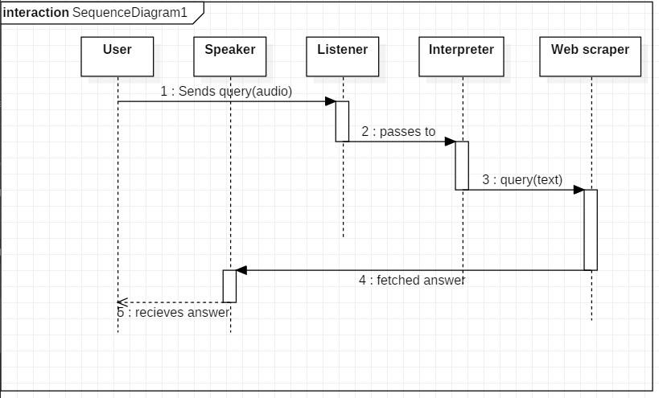
3.3 Sequence Diagram
3.3.1 Sequence diagram for Query-Response

Slide 12
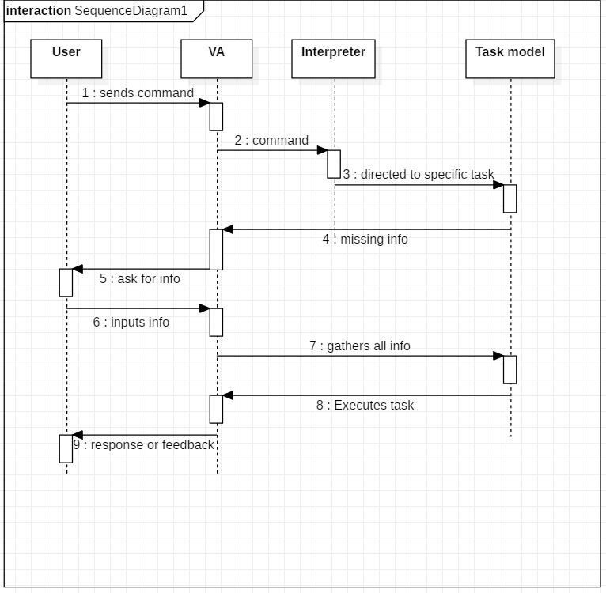
3.3.2 Sequence diagram for Task Execution

Slide 13
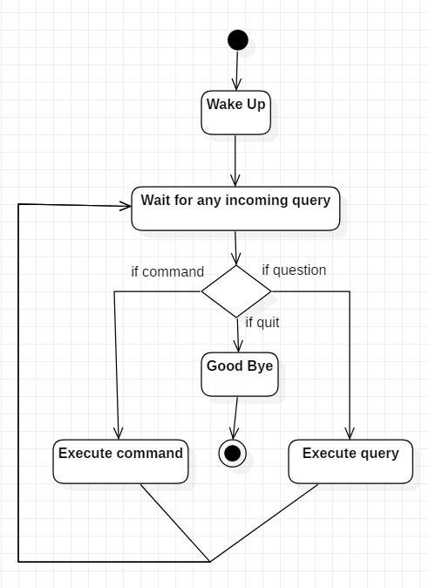
3.4 Activity Diagram

Slide 14
User interface
4

Slide 15
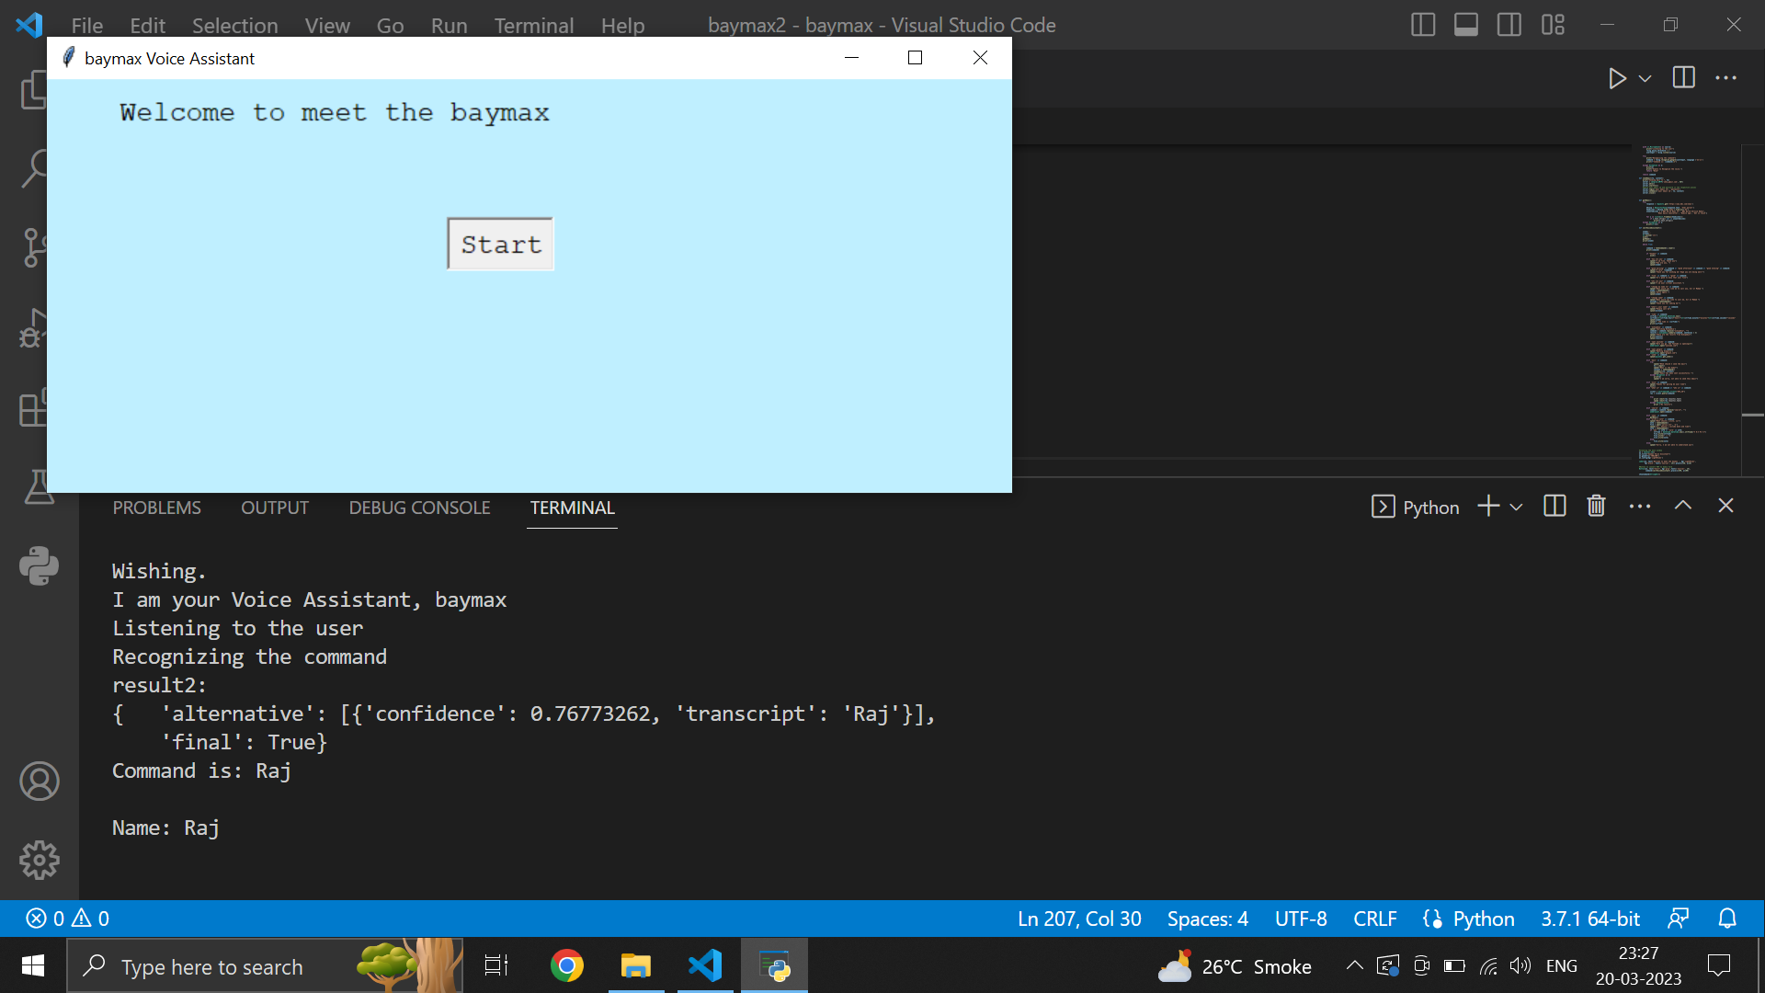
4.1 Snap-Shot

Slide 16
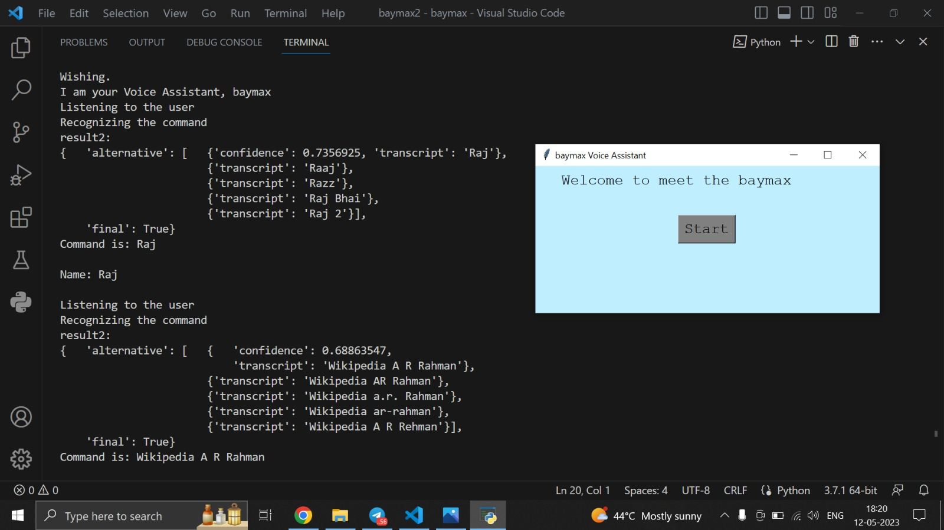

Slide 17
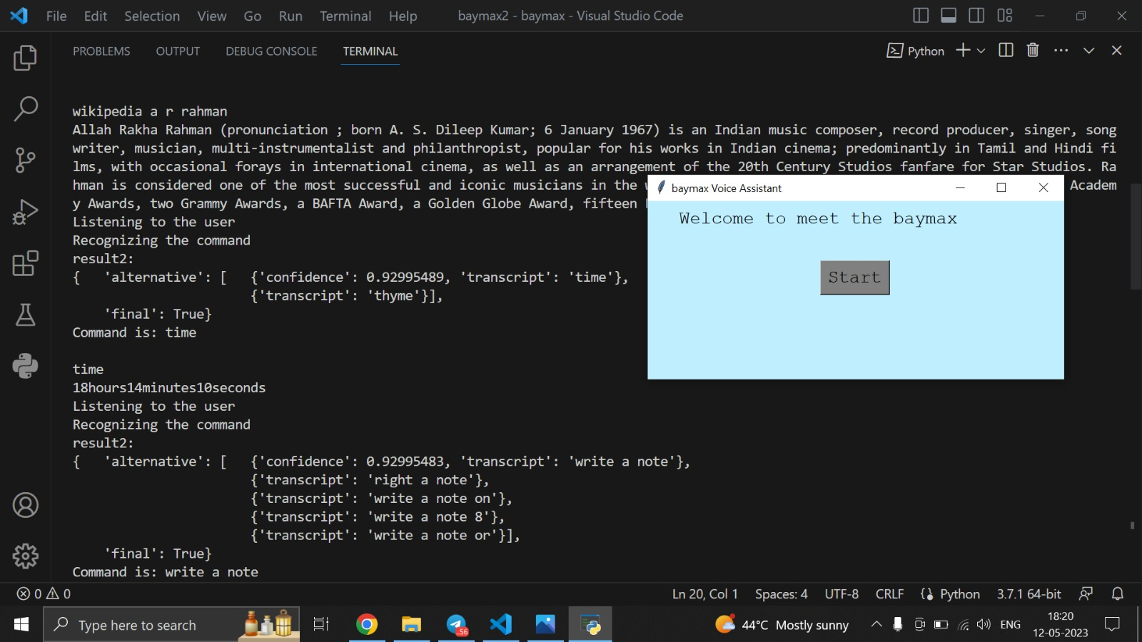

Slide 18
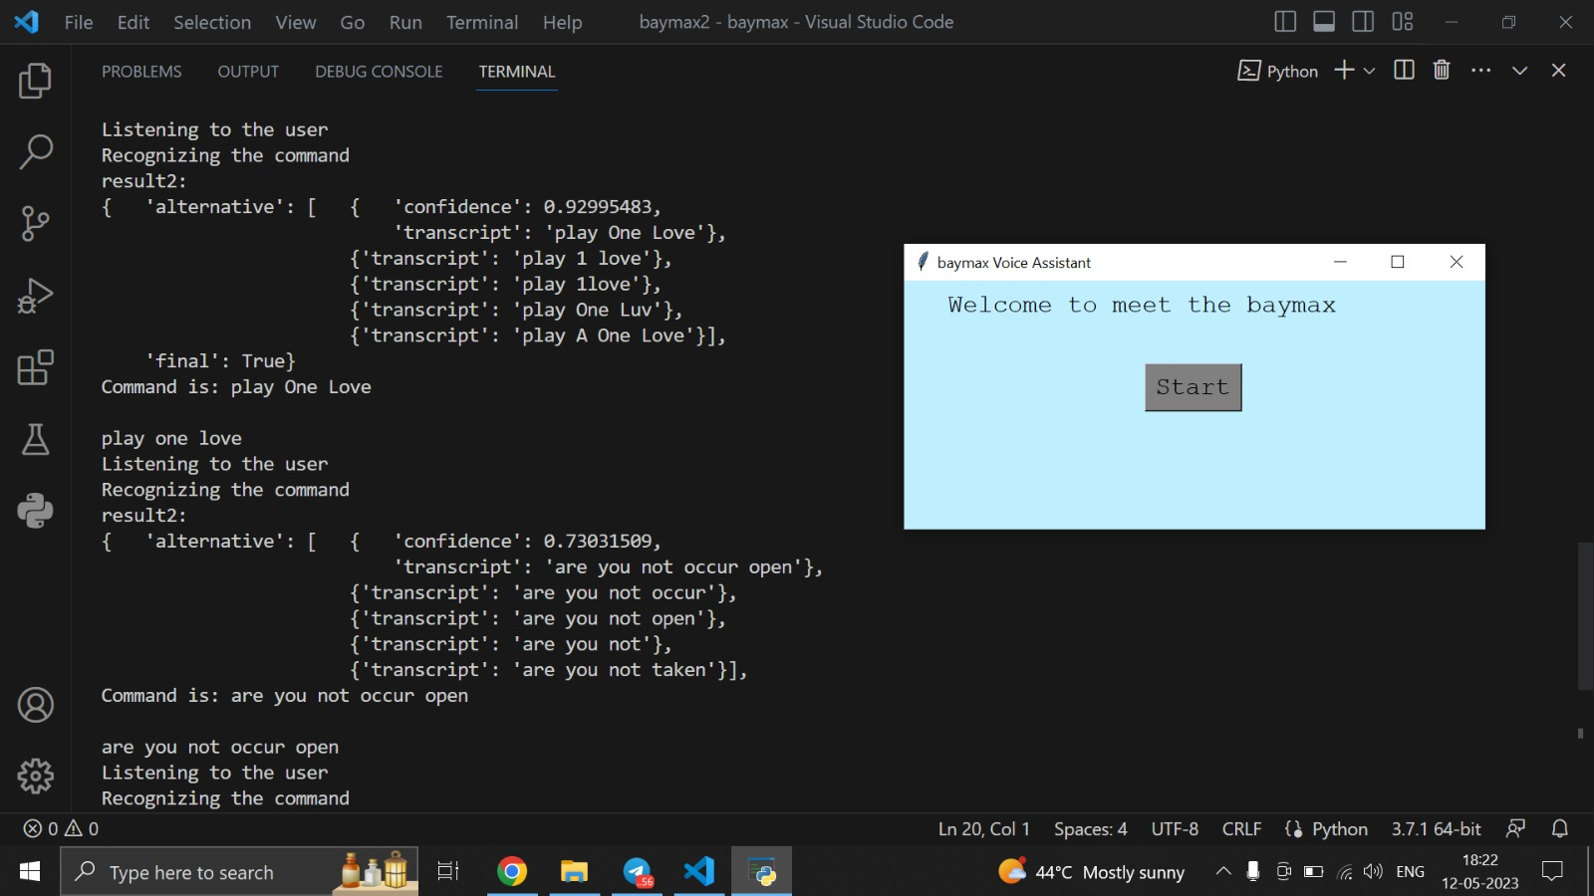

Slide 19
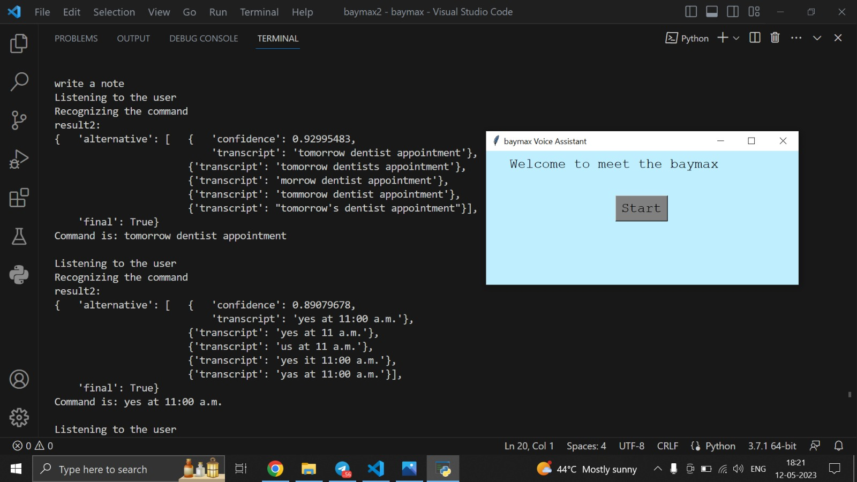

Slide 20
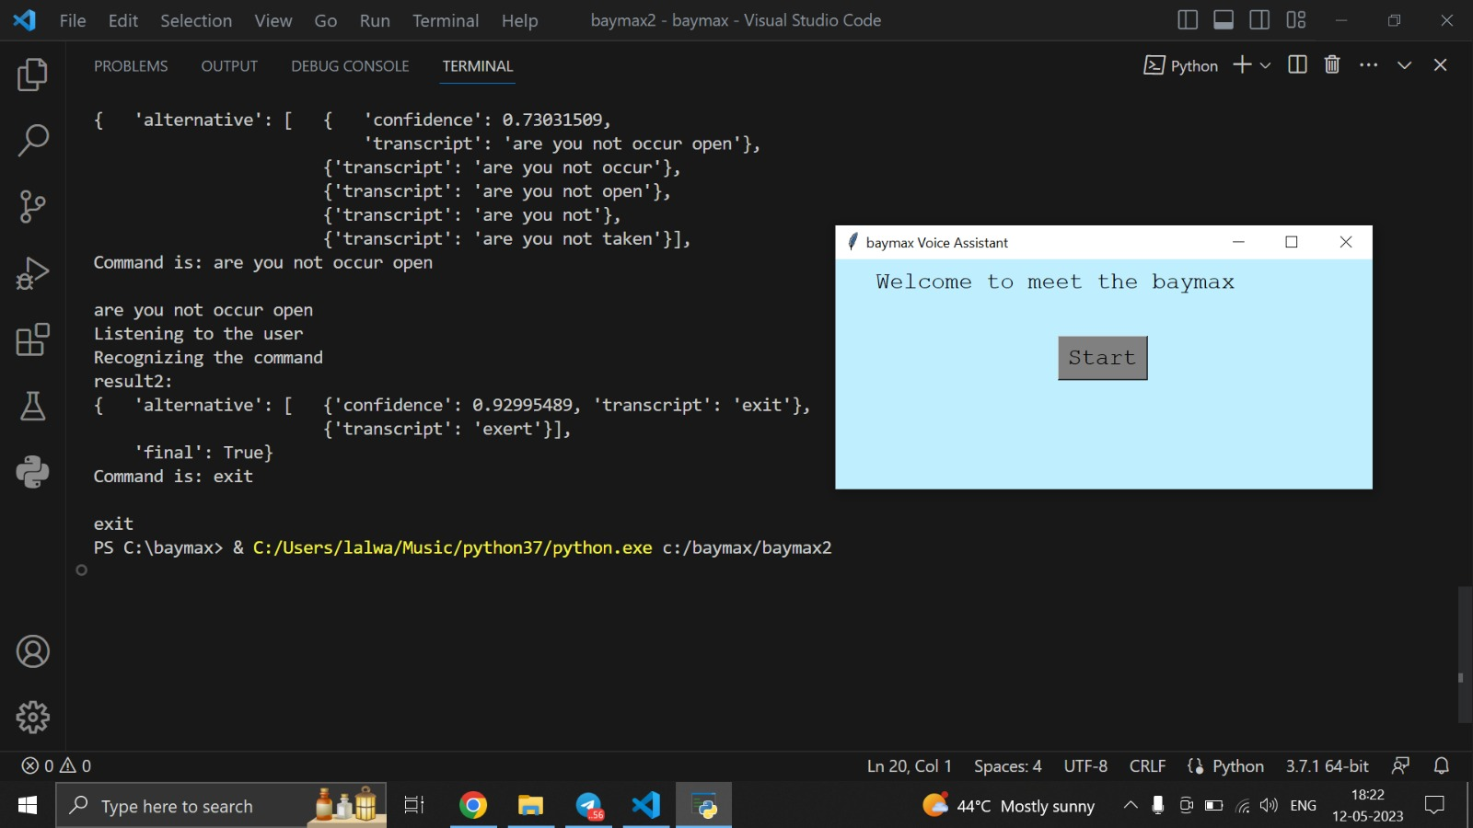

Slide 21
Thank You

